Slide 1
System and Cyber Security
L. Budi Handoko, M.Kom. (handoko@dosen.dinus.ac.id /
handoko@dsn.dinus.ac.id)
Dian Nuswantoro University

Slide 2
Cyber Security Framework
Cybersecurity frameworks are an essential set of documents that help reduce the risk of cyber attacks. These guidelines, standards and best practices ensure that any vulnerabilities or weaknesses present can be managed proactively in order to protect against malicious hackers and other criminals who may attempt to exploit them.

Slide 3
Why Do Organizations Require
It’s provide organizations with an invaluable advantage— they can accurately assess their current security stance and pinpoint any potential weaknesses. This allows you to make informed decisions on where to allocate resources for enhancing safety.

Slide 4
5 Main Processes Defining Security Approach
The Identify process helps identify and understand the assets that need to be protected
Protect process identifies the controls needed to secure the assets
The Detect process focuses on identifying any threats
Response process outlines the steps to be taken in the event of a security incident
Recover process aims to recover the systems and data after an attack or a breach

Slide 5
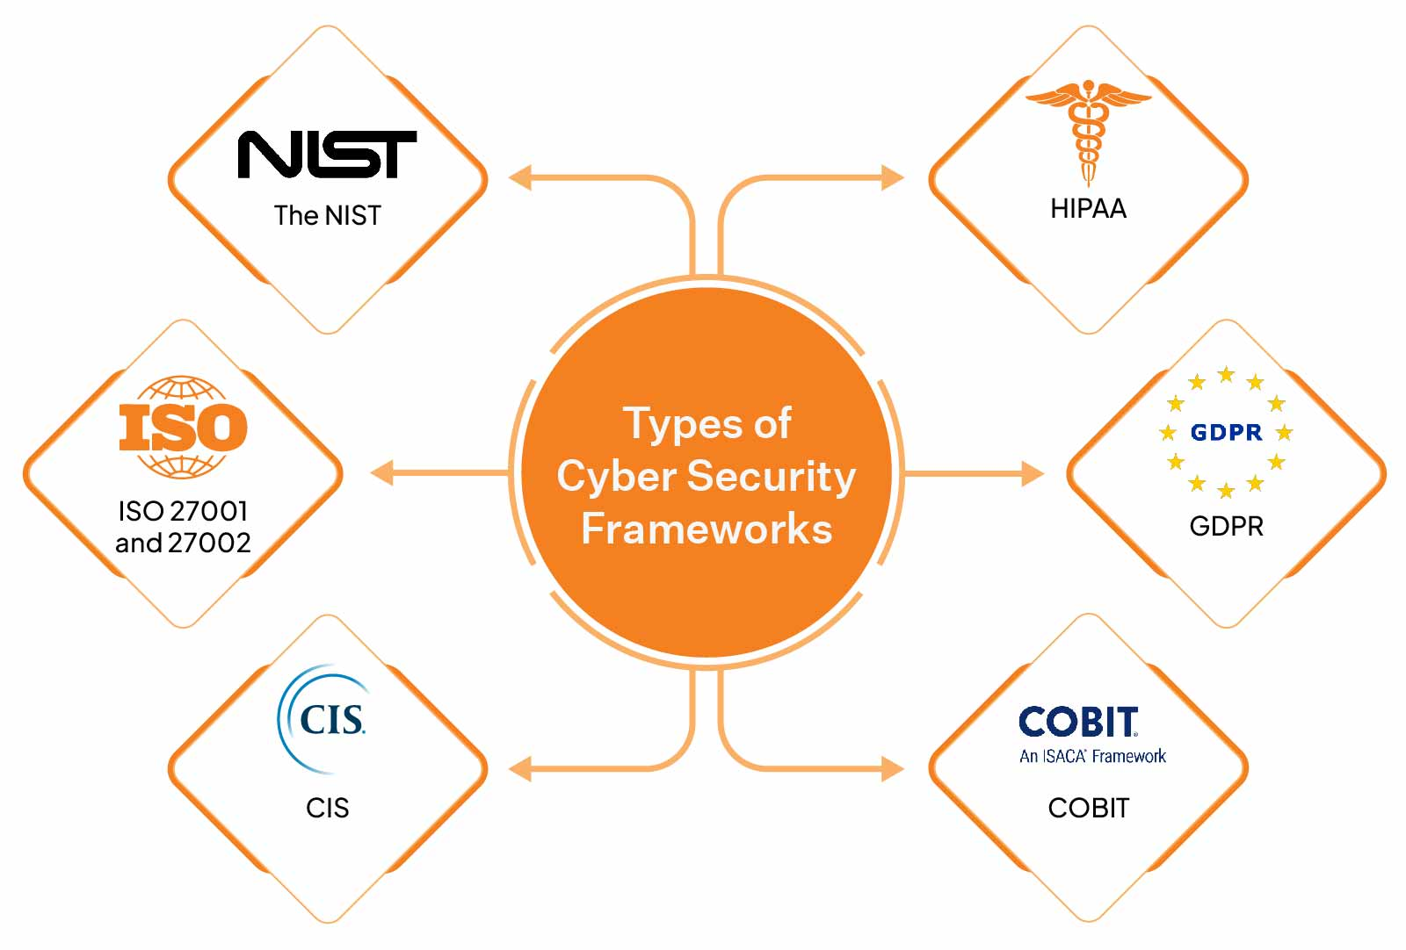

Slide 6
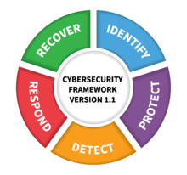
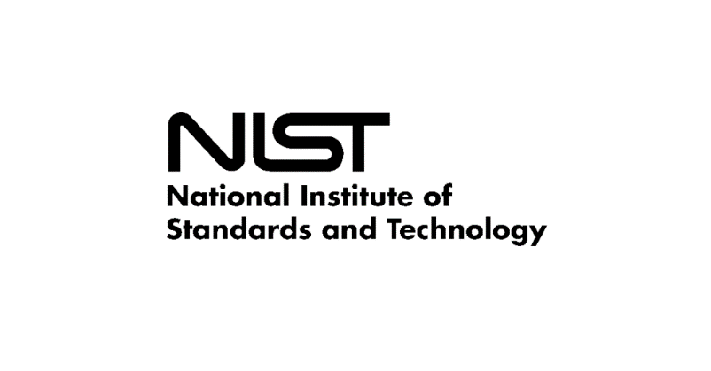
National Institute od Standards and Technology (NIST)
The NIST framework, designed to protect America’s critical infrastructure from cyberattacks, was the answer to an Executive Order issued by the Obama Administration. A tool for private sector companies to detect, respond to, and recover from cyber threats, it features five key functions :
Identify
Protect
Detect
Respond
Recover

Slide 7
NIST - Identify
Develop the organizational understanding to manage cybersecurity risk to systems, assets, data, and capabilities.
Asset Management (ID.AM): The data, personnel, devices, systems, and facilities that enable the organization to achieve business purposes are identified and managed consistent with their relative importance to business objectives and the organization's risk strategy.
Business Environment (ID.BE): The organization's mission, objectives, stakeholders, and activities are understood and prioritized; this information is used to inform cybersecurity roles, responsibilities, and risk management decisions.
Governance (ID.GV):- The policies, procedures, and processes to manage and monitor the organization's regulatory, legal, risk, environmental, and operational requirements are understood and inform the management of cybersecurity risk.
Risk Assessment (ID.RA): The organization understands the cybersecurity risk to organizational operations (including mission, functions, image, or reputation), organizational assets, and individuals.
Risk Management Strategy (ID.RM): The organization's priorities, constraints, risk tolerances, and assumptions are established and used to support operational risk decisions.
Supply Chain Risk Management (ID.SC): The organization's priorities, constraints, risk tolerances, and assumptions are established and used to support risk decisions associated with managing supply chain risk. The organization has in place the processes to identify, assess and manage supply chain risks.

Slide 8
NIST - Protect
Develop and implement the appropriate safeguards to ensure delivery of critical infrastructure services.
Access Control (PR.AC): Access to assets and associated facilities is limited to authorized users, processes, or devices, and to authorized activities and transactions.
Awareness and Training (PR.AT): The organization's personnel and partners are provided cybersecurity awareness education and are adequately trained to perform their information security-related duties and responsibilities consistent with related policies, procedures, and agreements.
Data Security (PR.DS): Information and records (data) are managed consistent with the organization's risk strategy to protect the confidentiality, integrity, and availability of information.
Information Protection Processes and Procedures (PR.IP): Security policies (that address purpose, scope, roles, responsibilities, management commitment, and coordination among organizational entities), processes, and procedures are maintained and used to manage protection of information systems and assets.
Maintenance (PR.MA): Maintenance and repairs of industrial control and information system components is performed consistent with policies and procedures.
Protective Technology (PR.PT): Technical security solutions are managed to ensure the security and resilience of systems and assets, consistent with related policies, procedures, and agreements.

Slide 9
NIST - Detect
Develop and implement the appropriate activities to identify the occurrence of a cybersecurity event.
Anomalies and Events (DE.AE): Anomalous activity is detected in a timely manner and the potential impact of events is understood.
Security Continuous Monitoring (DE.CM): The information system and assets are monitored at discrete intervals to identify cybersecurity events and verify the effectiveness of protective measures.
Detection Processes (DE.DP): Detection processes and procedures are maintained and tested to ensure timely and adequate awareness of anomalous events.

Slide 10
NIST - Respond
Develop and implement the appropriate activities to take action regarding a detected cybersecurity incident.
Response Planning (RS.RP): Response processes and procedures are executed and maintained, to ensure timely response to detected cybersecurity events.
Communications (RS.CO): Response activities are coordinated with internal and external stakeholders, as appropriate, to include external support from law enforcement agencies.
Analysis (RS.AN): Analysis is conducted to ensure adequate response and support recovery activities.
Mitigation (RS.MI): Activities are performed to prevent expansion of an event, mitigate its effects, and eradicate the incident.
Improvements (RS.IM): Organizational response activities are improved by incorporating lessons learned from current and previous detection/response activities.

Slide 11
NIST - Recover
Develop and implement the appropriate activities to maintain plans for resilience and to restore any capabilities or services that were impaired due to a cybersecurity incident.
Recovery Planning (RC.RP): Recovery processes and procedures are executed and maintained to ensure timely restoration of systems or assets affected by cybersecurity events.
Improvements (RC.IM): Recovery planning and processes are improved by incorporating lessons learned into future activities.
Communications (RC.CO): Restoration activities are coordinated with internal and external parties, such as coordinating centers, Internet Service Providers, owners of attacking systems, victims, other CSIRTs, and vendors.

Slide 12

Any Question ?
Anything to discuss ?

Slide 13
ISO 27001 and 27002
It’s a globally accepted standard for managing information security across internal situations and third parties.
To use it, you must have an Information Security Management System set up – it includes 114 super stringent controls divided into 14 categories. That might sound daunting (and it is!), but once implemented, these standards can act as a huge selling point for your organization and help draw in new customers who want to feel protected against potential threats.

Slide 14
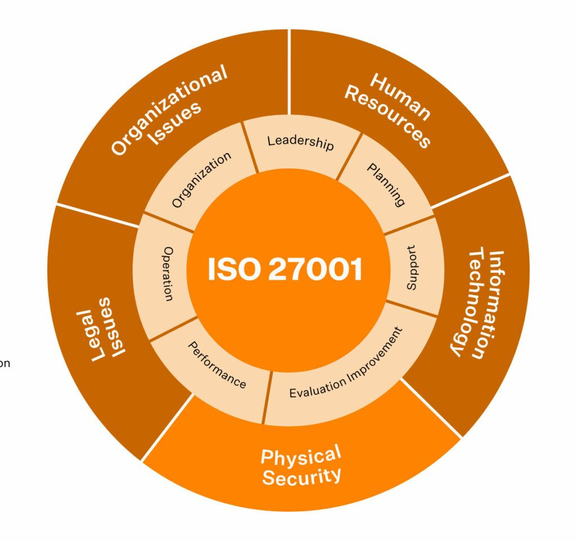
ISO / IEC 27001
Requires that management :
Systematically examine the organization's information security risks, taking account of the threats, vulnerabilities, and impacts;
Design and implement a coherent and comprehensive suite of information security controls and/or other forms of risk treatment (such as risk avoidance or risk transfer) to address those risks that are deemed unacceptable; and
Adopt an overarching management process to ensure that the information security controls continue to meet the organization's information security needs on an ongoing basis.

Slide 15
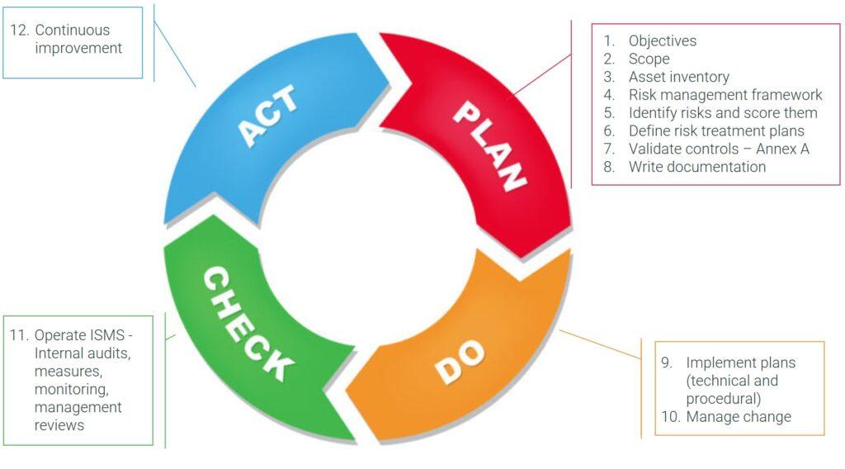
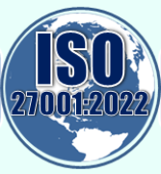

Slide 16
ISO / IEC 27001 Certification Process
Scoping : Organizations determine the scope of their ISMS, defining the boundaries and assets to be covered.
Risk Assessment : A risk assessment is conducted to identify and evaluate information security risks, ensuring that appropriate controls are implemented to manage these risks effectively.
Gap Analysis : A gap analysis compares the organization's existing information security practices against the requirements of ISO/IEC 27001 to identify areas for improvement.
ISMS Development : Based on the results of the risk assessment and gap analysis, the organization develops and implements its ISMS (Information security management system), incorporating the necessary security controls.
Internal Audits : Internal audits are conducted to assess the effectiveness and compliance of the implemented ISMS with the ISO/IEC 27001 standard.
Certification Audit : The organization undergoes an independent certification audit by an accredited certification body to assess its ISMS compliance with ISO/IEC 27001.
Certification Decision : If the audit demonstrates compliance, the organization is awarded the ISO/IEC 27001 certification.

Slide 17
3 Stage External Audit
Stage 1 is a preliminary review of the ISMS. It includes checks for the existence and completeness of key documentation, such as the organization's information security policy, Statement of Applicability (SoA), and Risk Treatment Plan (RTP). The auditor will have a brief meeting with some employees to review if their knowledge of the standard's requirements is at an acceptable level. They will decide if the organization is ready for the Stage 2 audit. They will also discuss any issues or specific situations prior to the Stage 2 audit and define the auditplan including subjects and who is needed on what day.
Stage 2 is a more detailed and formal compliance audit, independently testing the ISMS against the requirements specified in ISO/IEC 27001. The auditors will seek evidence to confirm that the management system has been properly designed and implemented, and is in fact in operation (for example by confirming that a security committee or similar management body meets regularly to oversee the ISMS). Certification audits are usually conducted by ISO/IEC 27001 Lead Auditors. Passing this stage results in the ISMS being certified compliant with ISO/IEC 27001.
Ongoing involves follow-up reviews or audits to confirm that the organization remains in compliance with the standard. Certification maintenance requires periodic re-assessment audits to confirm that the ISMS continues to operate as specified and intended. These should happen at least annually but (by agreement with management) are often conducted more frequently, particularly while the ISMS is still maturing.

Slide 18
Benefits
Enhanced Information Security Posture : ISO/IEC 27001 certification demonstrates a commitment to robust information security practices, bolstering the organization's ability to protect sensitive data and assets.
Building Trust with Customers and Stakeholders : Certification instils confidence in customers, partners, and stakeholders, assuring them that their information is handled with utmost care and security.
Meeting Regulatory and Legal Requirements : ISO/IEC 27001 certification aids in compliance with various data protection and privacy regulations, such as the General Data Protection Regulation (GDPR) in the European Union.
Competitive Advantage : Organizations with ISO/IEC 27001 certification gain a competitive edge over rivals, especially when participating in tenders or bidding for projects that require stringent security measures.
Risk Mitigation : By implementing a risk-based approach to information security, organizations can proactively identify and mitigate potential threats, reducing the likelihood of security incidents.
Incident Response Preparedness : The standard's incident management controls ensure that organizations are well-prepared to handle security incidents promptly and efficiently, minimizing their impact.

Slide 19
Any Question ?
Anything to discuss ?

Slide 20
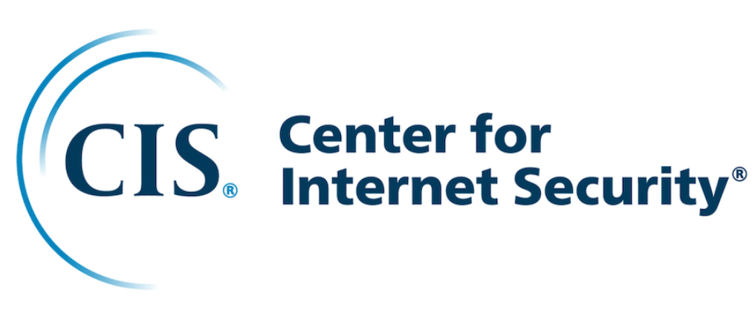
The Center for Internet Security Critical Security Controls (CIS)
CIS is the perfect level to start from if your company wants to increase cybersecurity step by step. Developed in the late 2000s, it provides 20 carefully-selected controls updated regularly by professionals from various industries like academia, government, and industry.
These controls span fundamental, foundational, and organizational levels mapped to common standards like HIPAA and NIST. Even those organizations not subject to particular protocols can benefit from its configurations that ensure their cyber security is up to scratch.

Slide 21
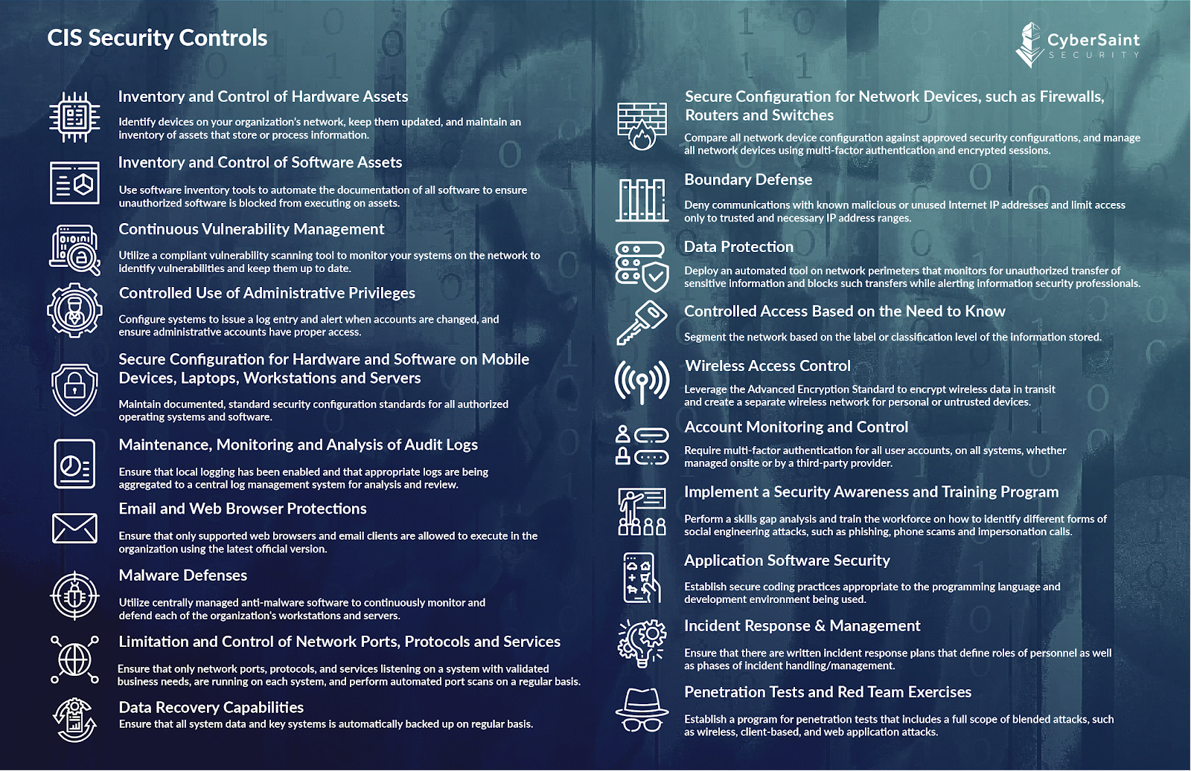

Slide 22
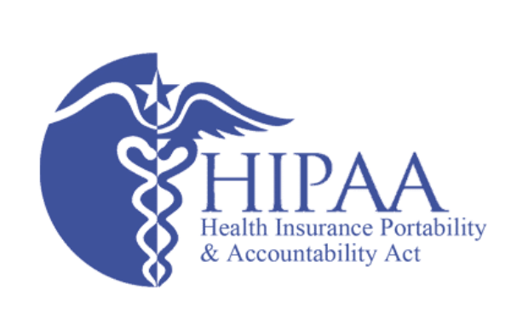
The Health Insurance and Portability and Accountability Act (HIPAA)
HIPAA is vital to the healthcare industry, serving as a defense against potential data breaches. This critical cyber security framework safeguards patient records and other confidential information, ensuring that all personal data remains secure.
Compliance with HIPAA ensures that all healthcare operators will provide their patients with the necessary privacy protocols to keep them relaxed and confident in their healthcare choice. Without it, individuals’ delicate healthcare data could be exposed quickly and without notice, leading to severe consequences for companies and consumers alike.

Slide 23
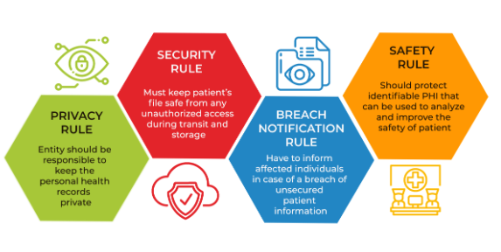

Slide 24
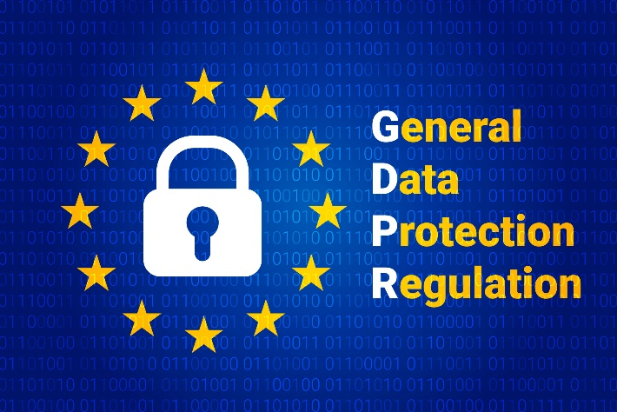
The General Data Protection Regulation (GDPR)
GDPR — the General Data Protection Regulation — is widely seen as one of the most stringent and secure programs for data privacy worldwide. It was developed by the European Union to better protect the data held by EU citizens, from SMEs to large organizations.
Its reach extends across borders, too; even companies based elsewhere but still offer services or products in Europe must abide by its rules when handling sensitive data in online transfers. This shows just how seriously they take protecting their citizens’ digital privacy – something we can all learn from.

Slide 25
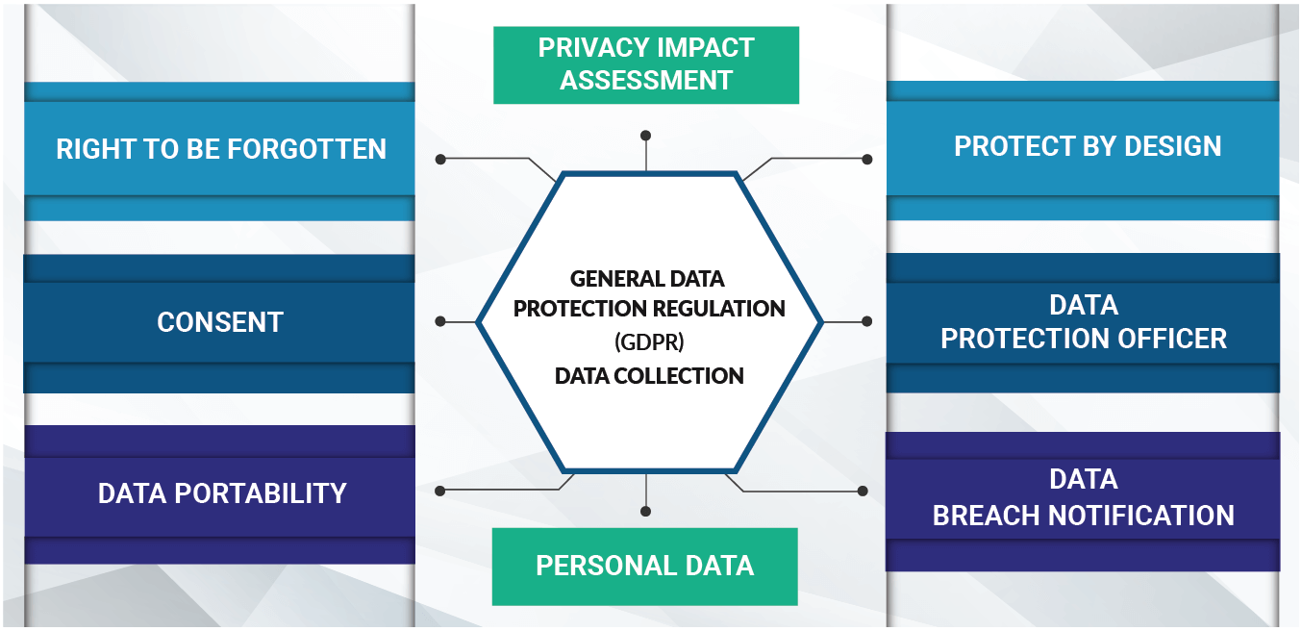

Slide 26
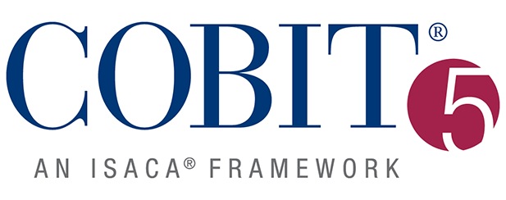
Control Objectives for Information and Related Technologies (COBIT)
The COBIT cybersecurity framework was created by the ISACA (Information Systems Audit and Control Association) to introduce a comprehensive IT governance and management system.
When implementing COBIT, organizations can take the necessary steps to protect data from all potential vulnerabilities, allowing them complete end-to-end coverage. It was an ambitious move, as the world has become increasingly reliant on technology, and large companies carry hefty amounts of sensitive data stored in cloud computing systems and social media accounts.
Although it may not seem evident initially, COBIT can provide a way for your organization to defend your information through proactive measures to enhance enterprise security.

Slide 27
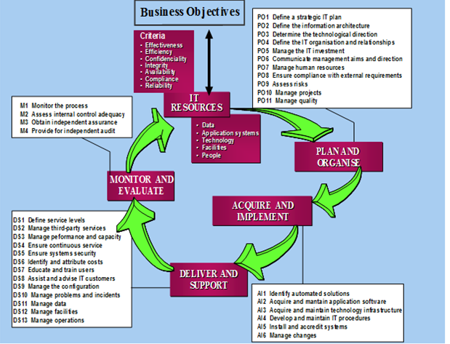

Slide 28

Indeks Keamanan Informasi (KAMI) – Badan Siber dan Sandi Negara (BSSN)
Sebuah aplikasi yang digunakan sebagai alat bantu untuk melakukan asesmen dan evaluasi tingkat kesiapan (Kelengkapan dan Kematangan) penerapan keamanan informasi berdasarkan kriteria SNI ~ ISO/IEC 27001.
Proses evaluasi dilakukan melalui sejumlah pertanyaan di beberapa area berikut:
Kategori Sistem Elektronik yang digunakan
Tata Kelola Keamanan Informasi
Pengelolaan Risiko Keamanan Informasi
Kerangka Kerja Keamanan Informasi
Pengelolaan Aset Informasi
Teknologi dan Keamanan Informasi
Suplemen (Tambahan pengukuran dilakukan untuk aspek Pengamanan Keterlibatan Pihak Ketiga Penyedia Layanan, Pengamanan Layanan Infrastruktur Awan (Cloud Service) dan Perlindungan Data Pribadi.

Slide 29
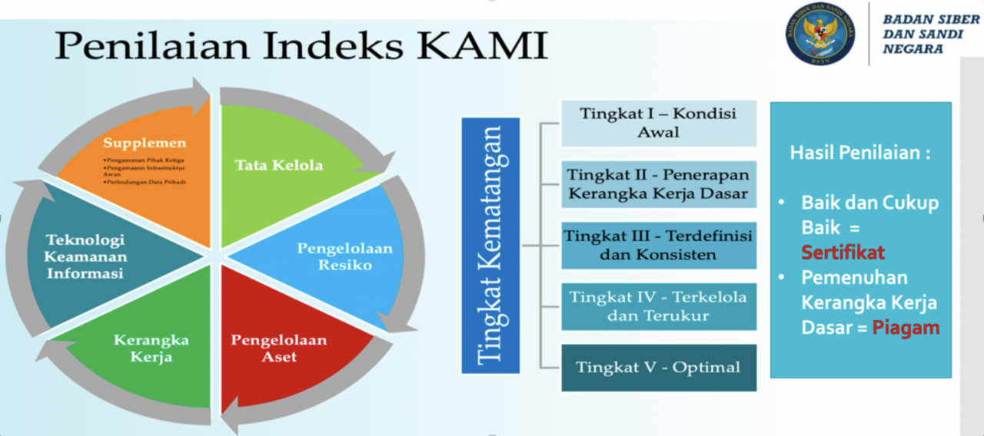

Slide 30
Tingkat Kematangan
Pengelompokan kedua dilakukan berdasarkan tingkat kematangan penerapan pengamanan dengan kategorisasi yang mengacu kepada tingkatan kematangan yang digunakan oleh kerangka kerja COBIT atau CMMI. Tingkat kematangan ini nantinya akan digunakan sebagai alat untuk melaporkan pemetaan dan pemeringkatan kesiapan keamanan informasi di Kementerian / Lembaga. Untuk keperluan Indeks KAMI, tingkat kematangan tersebut didefinisikan sebagai:
Tingkat I – Kondisi Awal
Tingkat II – Penerapan Kerangka Kerja Dasar
Tingkat III – Terdefinisi dan Konsisten
Tingkat IV – Terkelola dan Terukur
Tingkat V – Optimal

Slide 31
Any Question ?
Anything to discuss ?

Slide 32


